Slide 1
Portfolio Analyzer
By: Michael, Pankaj, Blandine and Omar

Slide 2
TABLE OF CONTENTS
Overview
Portfolio Performance and Optimization
01
02
Monte Carlo Simulation
Creating a Portfolio dashboard
03
04

Slide 3
Overview of Portfolio Analyzer
The Portfolio Analyzer analyzes the performance of stocks over a time period. Below are the 3 parts to our projects:
Create a Portfolio of Stocks and analyze the performance of various Portfolios by Sectors.
Optimization of most favourable portfolio.
Creating a dashboard with interactive visualization to view the performance of portfolios.

Slide 4
Data Extraction and Manipulation Tools
Data Collection: Yahoo Finance, ALPACA
Python Library Existing Libraries: Matplotlib, Pandas, Numpy, Hvplot, Plotly, Alpaca
New Libraries: yfinance, pandas_datareader

Slide 5
Approach
Identified the most favourable Portfolio based on returns, risk and Sharpe ratios.
Optimized the most favourable Portfolio using Monte Carlo Simulation and calculating the maximum Sharpe ratio.
Performed Monte Carlo Simulation to predict the return from a Portfolio over next 10 years.
Created interactive plots to view the returns generated from the portfolio and asses the risks associated with the Portfolio.

Slide 6
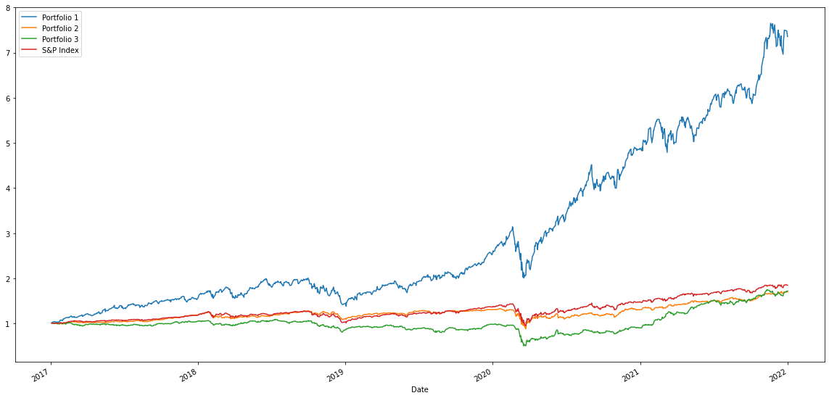
Part1: Create a Portfolio of Stocks and analyze the performance
Comparison of Cumulative Returns

Slide 7
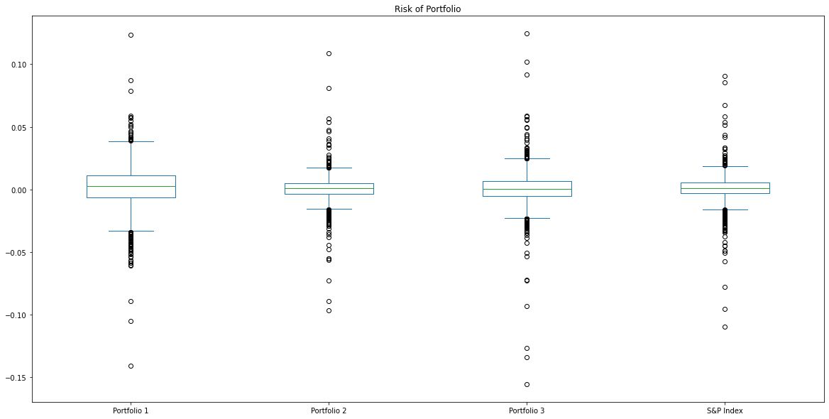
Part1: Create a Portfolio of Stocks and analyze the performance
Comparison of Standard Deviation - Box Plot

Slide 8
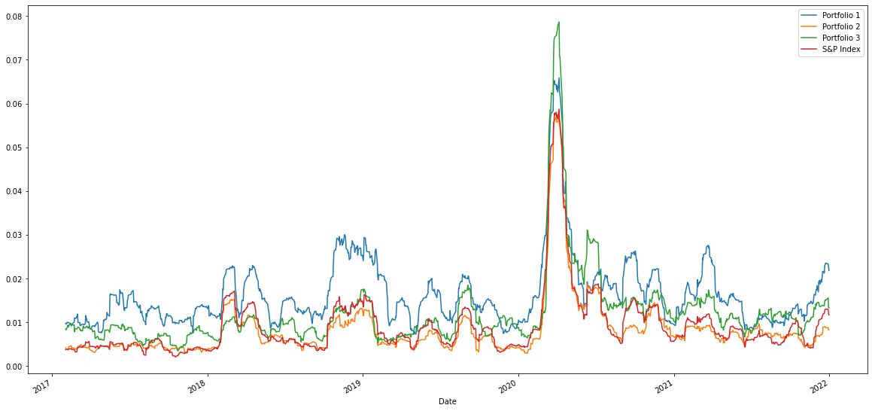
Part1: Create a Portfolio of Stocks and analyze the performance
Comparison of Rolling Betas

Slide 9
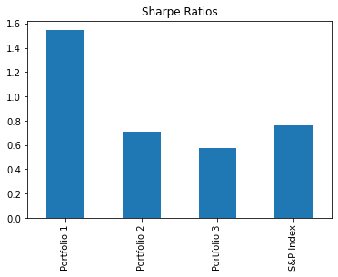
Part1: Create a Portfolio of Stocks and analyze the performance
Comparison of Sharpe Ratios

Slide 10
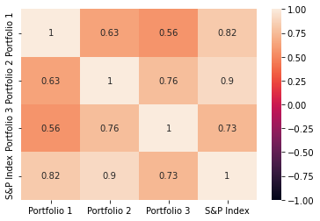
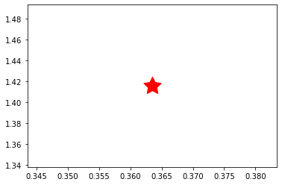
Part1: Create a Portfolio of Stocks and analyze the performance
Correlation Matrix

Slide 11
Part1: Create a Portfolio of Stocks and analyze the performance
Recommendations - part 1
The Standard deviation shows Portfolio 2 is least risky and less riskier than than the overall market (S&P Index)
Based on the beta plot, Portfolio 1 beta was much higher than the other 2 portfolios and the market.
The Sharpe ratios shows that Portfolio 1 has highest Sharpe ratio of 1.54 and it can generate maximum return given the risk of Portfolio.
The MC Simulation analysis shows that the optimal portfolio with max sharpe ratio would give a return of 165% over 5 years.

Slide 12
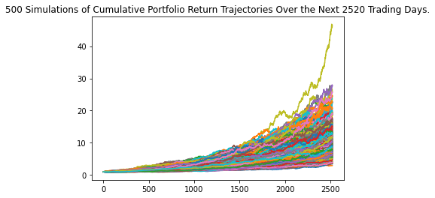
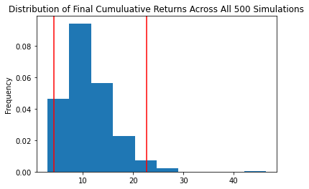
Part2: Monte Carlo simulations to model the probability
Monte Carlo Simulation

Slide 13
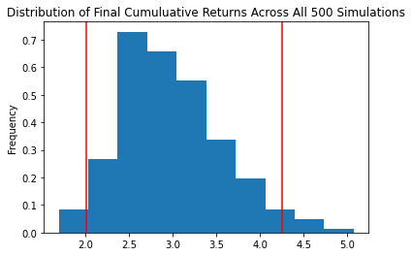
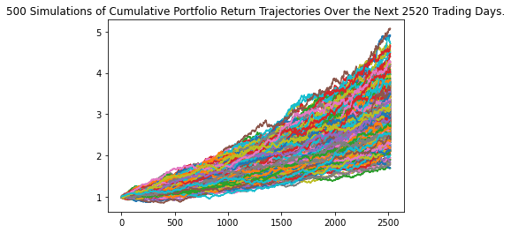
Part2: Monte Carlo simulations to model the probability
Monte Carlo Simulation

Slide 14
Part2: Monte Carlo simulations to model the probability
Recommendations - part 2
Retirement analysis by investing in Portfolio 1:
The Monte Carlo Simulation shows that the Portfolio 1 can generate at least $216k and maximum $1.13 M over the next 10 years for clients.
Retirement analysis by investing 25% in Portfolio 1, 25% in SPY and 50% in Bonds:
The new Monte Carlo Simulation shows that the less riskier portfolio can generate at least $100k and maximum $212k over the next 10 years for clients which seems a reasonable returns for a conservative investor.

Slide 15
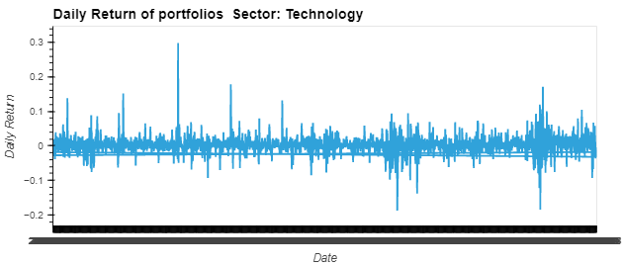
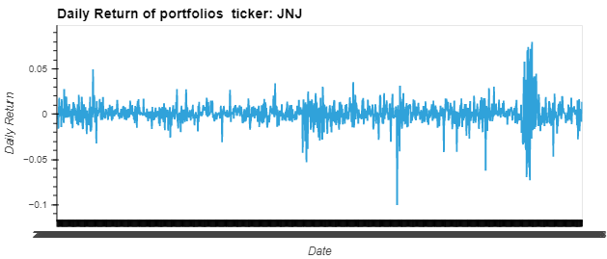
Part3: Creating a Portfolio dashboard for clients to view the returns from various portfolios over time
Creating a Portfolio dashboard

Slide 16
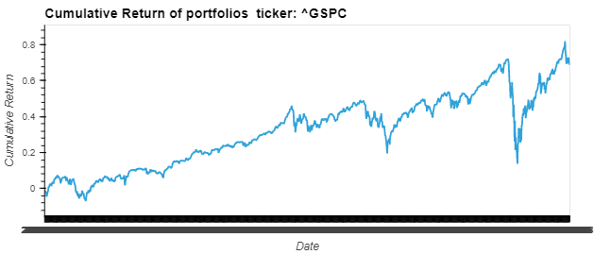
Part3: Creating a Portfolio dashboard for clients to view the returns from various portfolios over time
Creating a Portfolio dashboard

Slide 17
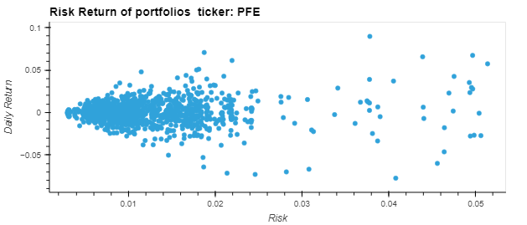
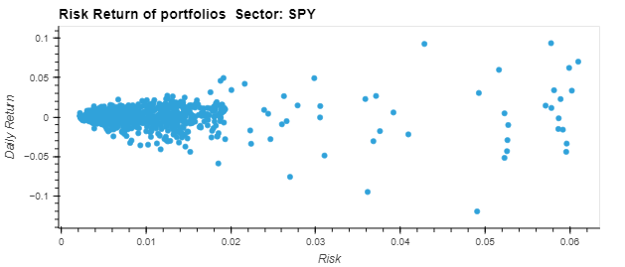
Part3: Creating a Portfolio dashboard for clients to view the returns from various portfolios over time
Creating a Portfolio dashboard

Slide 18
Part3: Creating a Portfolio dashboard for clients to view the returns from various portfolios over time
Recommendations - part 3
The HvPlot shows that Technology Sector returns were much larger than the other 2 sectors and overall market.
The 5 different HvPlots would help a investor to determine the stocks to choose based on risk appetite and returns associated with them.
A younger investor would like to create a portfolio of stocks weighing more in technology, whereas a conservative investor might go with the SPY index funds or Combination of equity and Bonds.

Slide 19
Additional Questions
We could have used other python libraries such as pyfolio and Import Dash to further analyze the performance of the Portfolios and visualize the plots in a single dashboard.
More research and time needed to incorporate the above and we definitely plan to include more libraries in future.
We could have included financial ratios such as P/E ratio to analyze the profitability of the stocks and companies. We would also like to include the financial ratios in our analysis in future.

Slide 20
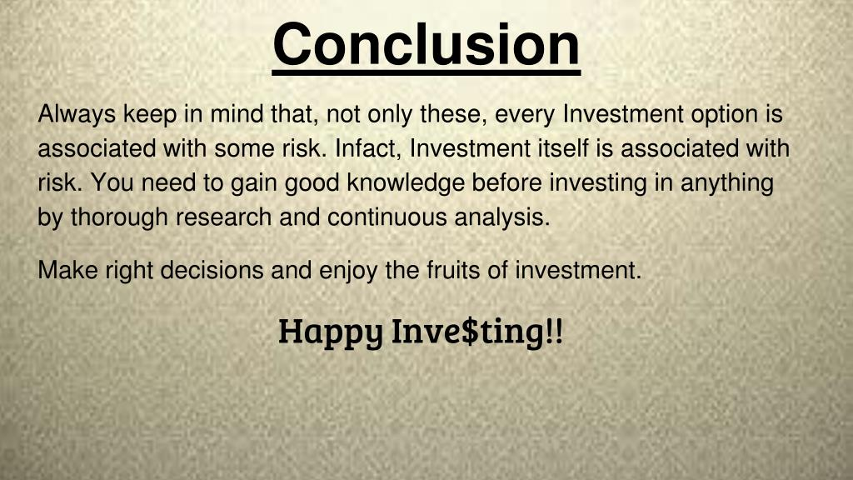

Slide 21


